Slide 1
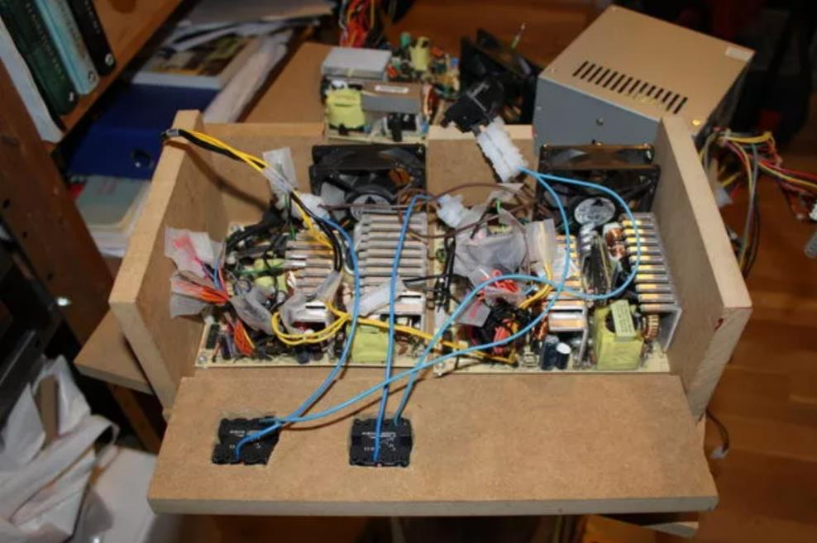
Intro to DC Electronics
Jan-2023

Slide 2


Rules of thumb, assumptions and mixed-quality analogies to come!

Slide 3
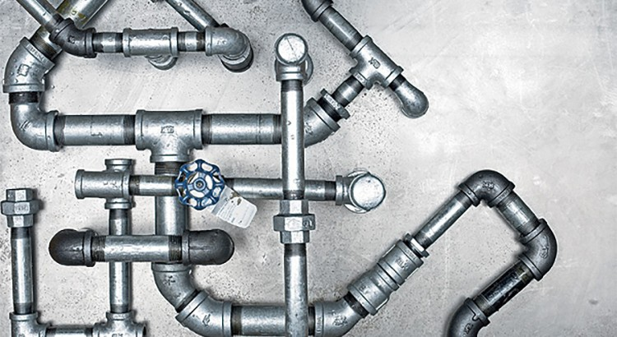
Plumbing Analogy

Slide 4
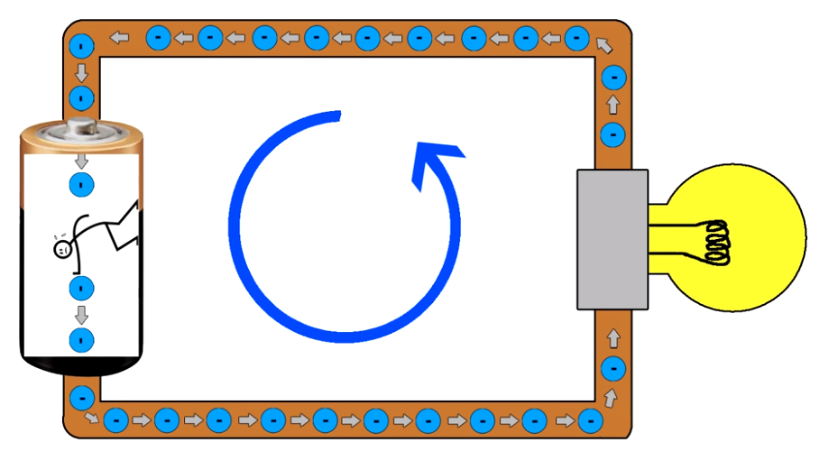
What is Voltage?
Voltage is the pressure (pushing force)
Pushes electrons through a circuit

Slide 5
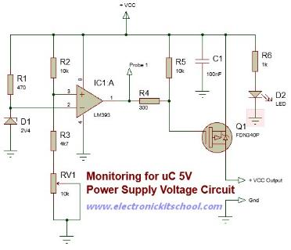
Powering a Complex Circuit
12V
Voltage is applied across any circuit to power it

Slide 6
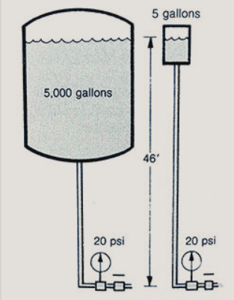
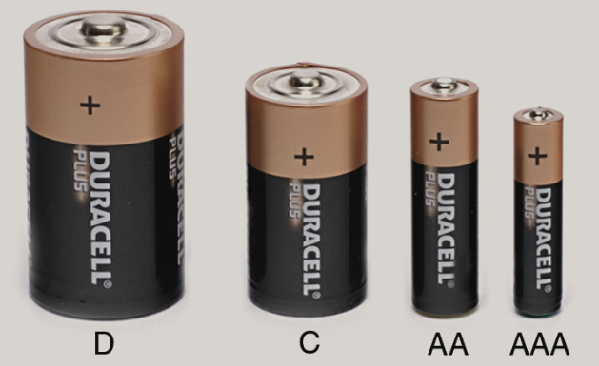
Voltage
+
+
+
+
1.5V
1.5V
1.5V
1.5V
-
-
-
-

Slide 7
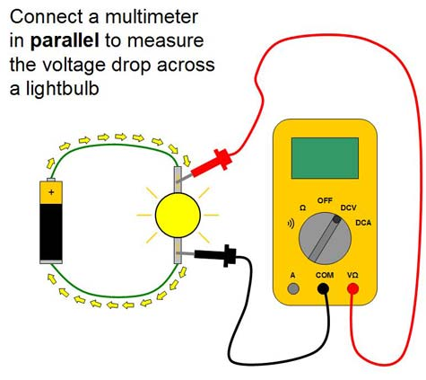
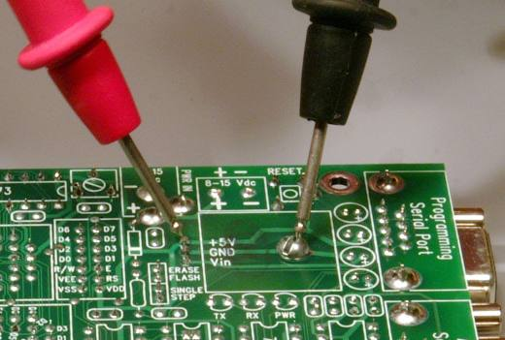
Measuring Voltage
Voltage is measured between/across two points:
Positive minus negative
Convention - red minus black

Slide 8
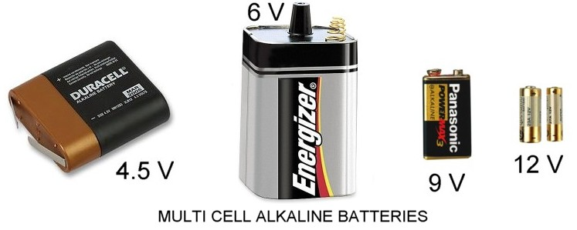

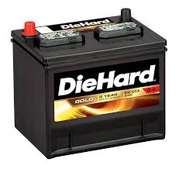
Common Voltages
Volts DC:
9V or 9VDC or 9V DC
110 volts AC
110V or 110V AC or
110VAC
12V DC or
12V

Slide 9
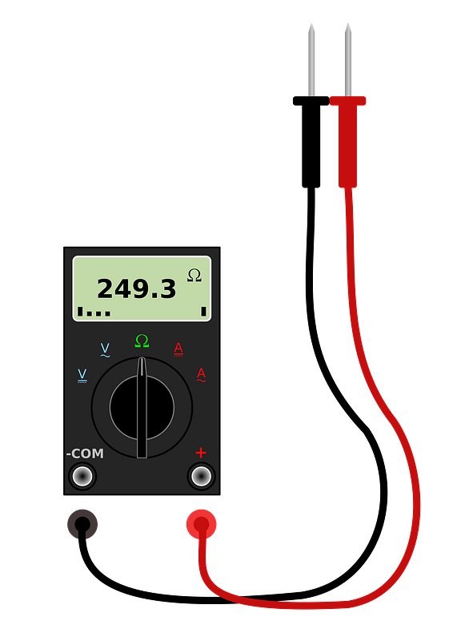
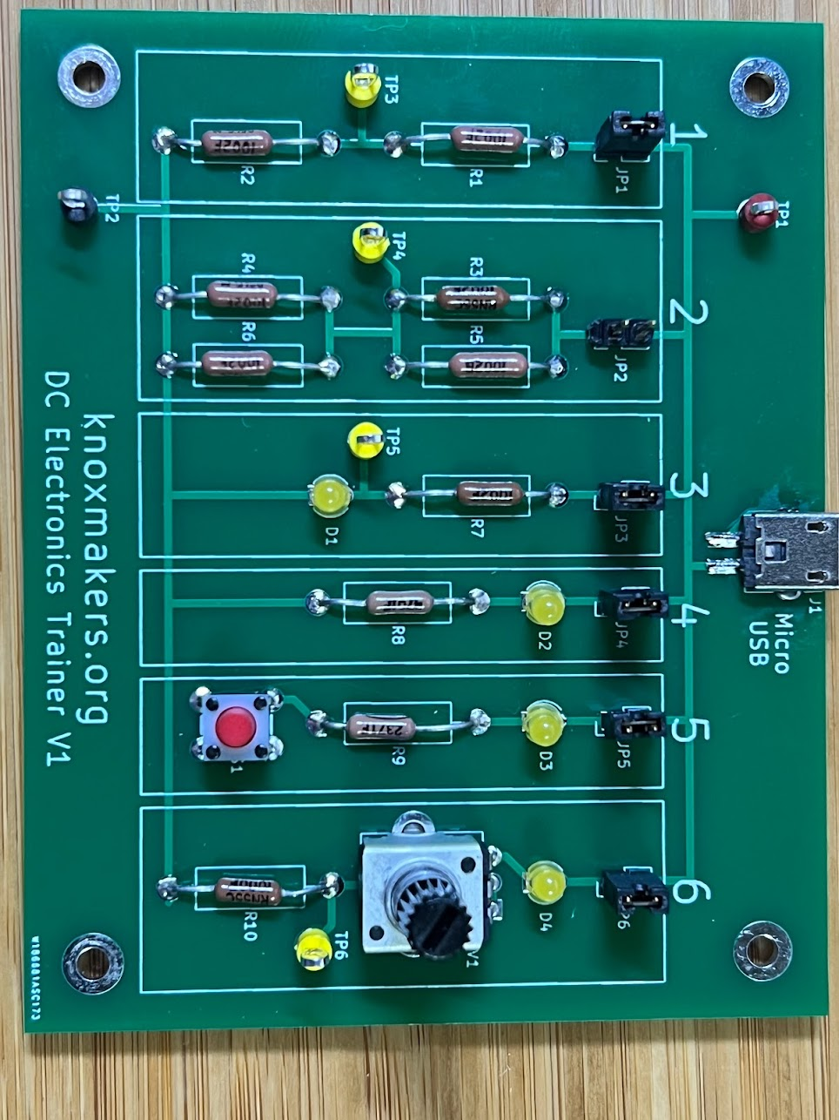
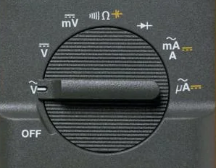
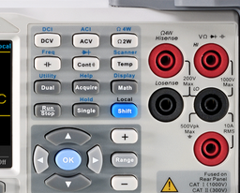
Let’s Try It!
5V DC
Jumper
2.5V DC
Ground

Slide 10
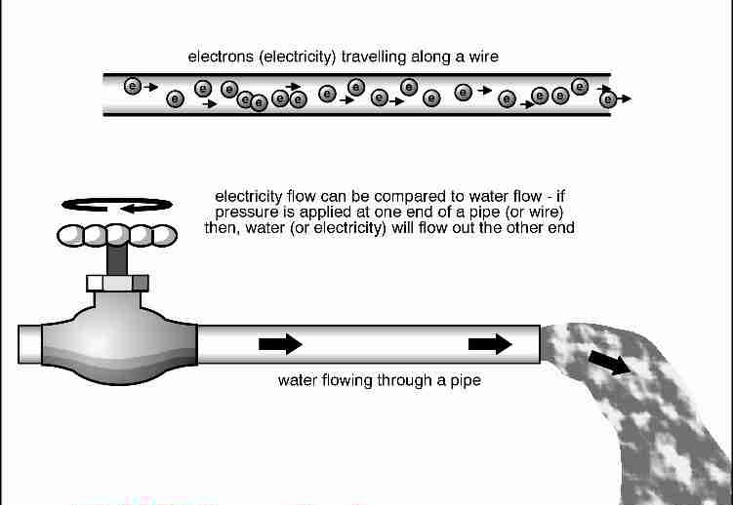
Current
Current is the flow of electrons
Similar to the flow of water

Slide 11
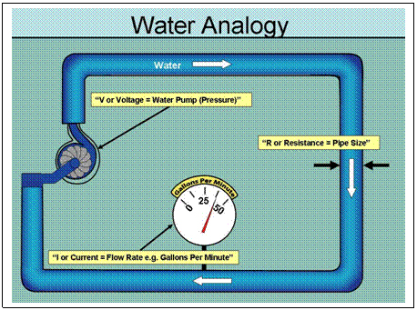
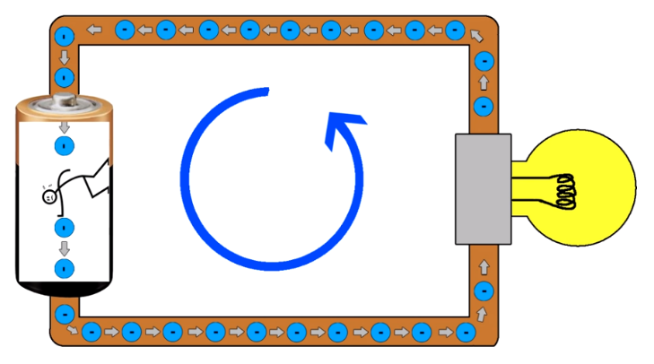
Current
Current flows THROUGH a conductor
Measured in amps
1A (1 amp) = 6.25 x 10¹⁸ electrons per second

Slide 12
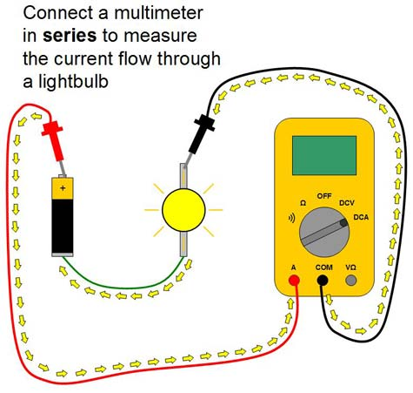
Measuring Current
Current can be measured by passing it through a multimeter

Slide 13
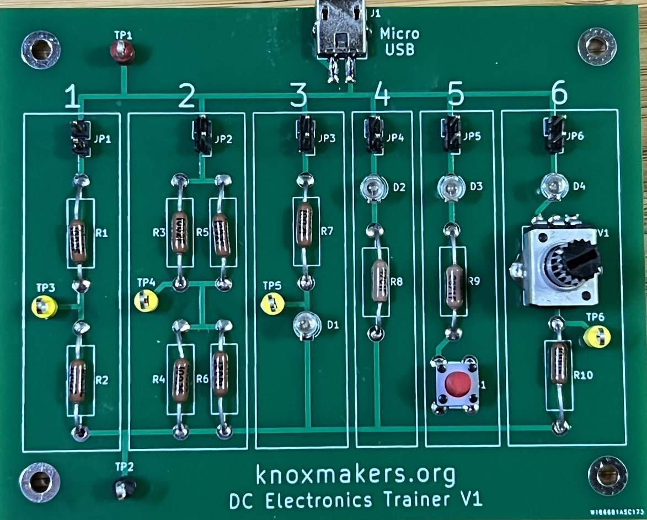
Let’s Try It!
~0.5mA DC
Remove Jumper

Slide 14
“Voltage Across” – “Current Through”
Voltage
Current

Slide 15
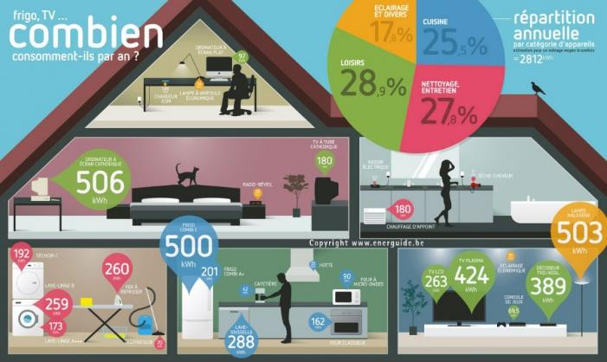
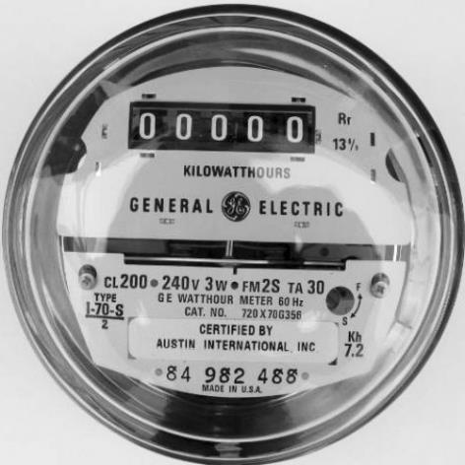
Power
Power = Watts = Amount of energy used at a particular point in time
Energy =
Power x Time = W x hr
Total energy used over a period of time

Slide 16
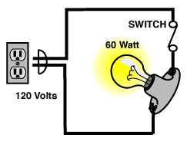
Calculating Power
Power = Voltage x Current
120V x 0.5A = 60W

Slide 17
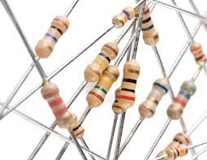
Resistors – A minute to learn, a lifetime to master

Slide 18
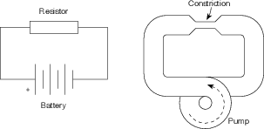
Resistors – Resist the flow of current
Resistance – measured in Ohms (Ω)

Slide 19
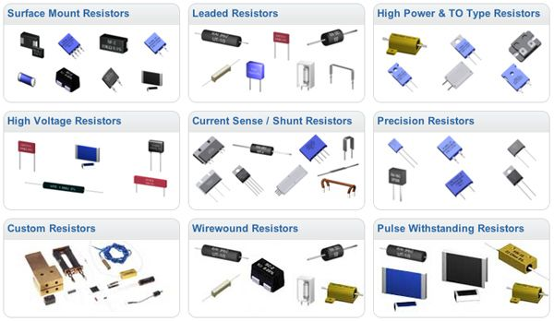
All Shapes and Sizes

Slide 20

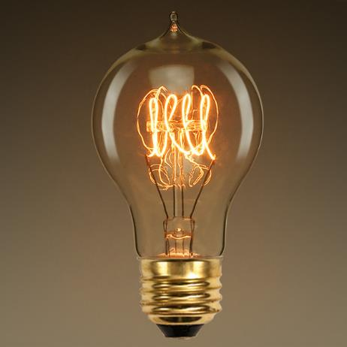
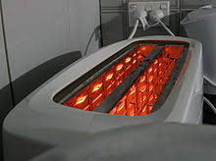
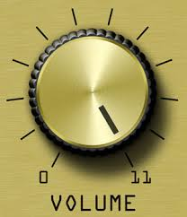
We use resistors every day

Slide 21
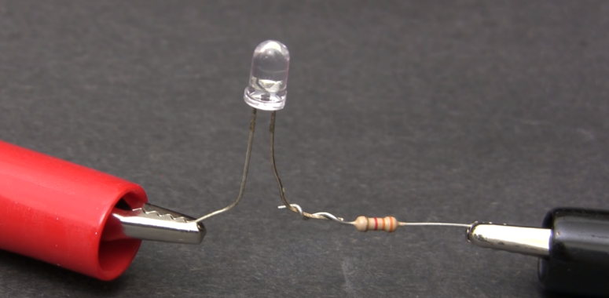
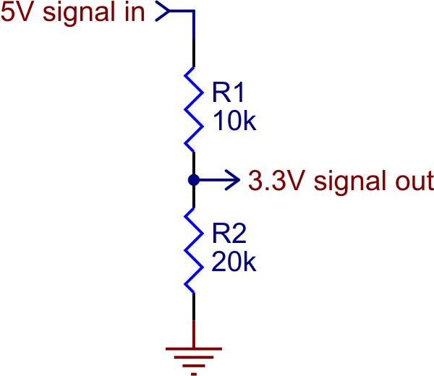
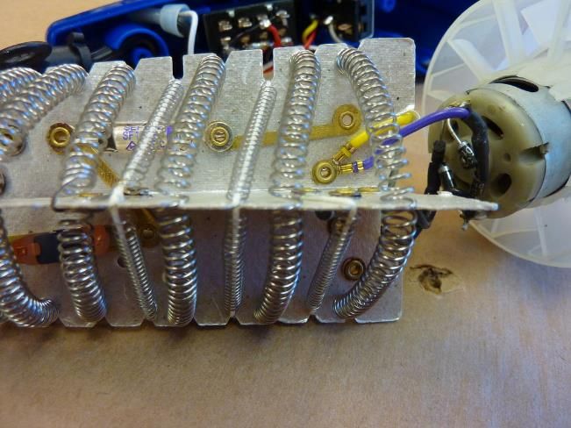
Resistors – Simple but useful!

Slide 22
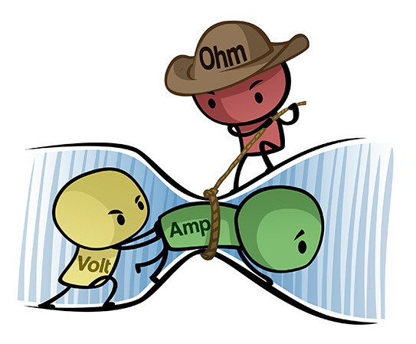
Ohm’s Law
V = I * R
Special Relationship between voltage, current, resistance

Slide 23
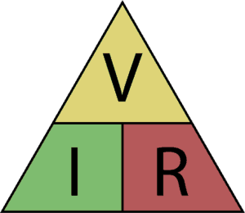
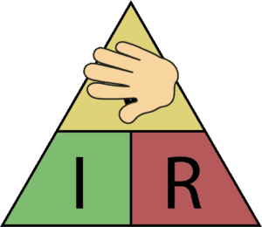
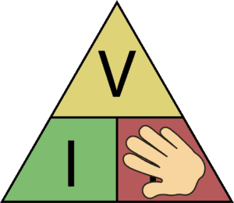
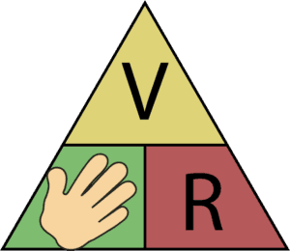
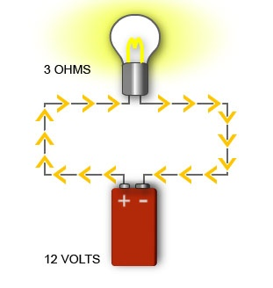
Ohm’s Law
V = I * R
R = V / I
I = V / R
R=?
I=0.5A
I=?
120V

Slide 24
Let’s Try It!
Remove jumper, measure R
R = 500Ω
Place jumper, measure V
V = I * R
R = V / I
V = 2.3V
I = V / R

Slide 25
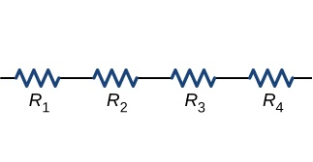

Resistors in Series
=
10Ω
10Ω
10Ω
10Ω
40Ω
R₁ + R₂ + R₃ + R₄

Slide 26
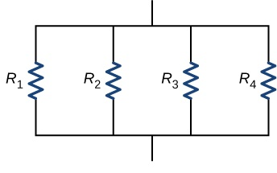

Resistors in Parallel
=
40Ω
40Ω
40Ω
40Ω
R_{T}
10Ω
1
R_{T} =
1
R₁
+
1
R₂
+
1
R₃
+
1
R₄

Slide 27
Let’s Try It!
Remove
Jumpers!
Remove jumpers, measure each R
10kΩ
R₁ = R₂ = 10kΩ
5kΩ
R₃//R₅ = 5kΩ
R₃ = R₅ = 10kΩ
5kΩ
10kΩ

Slide 28
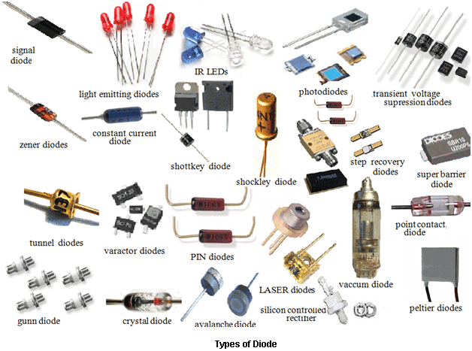
Diodes/LEDs

Slide 29
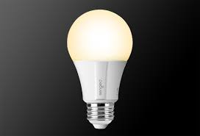

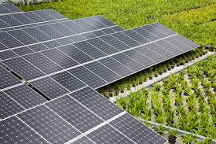
Diodes – Everyday Uses

Slide 30
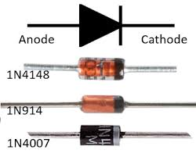
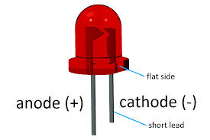
Diodes – One-Way Gate
Current Flow
LED

Slide 31
How to use a diode
I_{LED}
R
V_{S} > V_{LED} + 1V
I_{LED} ~ 10-20mA
V_{LED} ~ 1.8-3.3V
V_{S}
+
-
+
V_{LED}
-

Slide 32
Practical Circuit
I = 5mA
R = ?
V_{S} = 5V
+
-
+
V_{LED} = 2.7V
R = V / I
-
R = (5V – 2.7V) / 0.01A
= 2.3V / 0.005A
= 460Ω

Slide 33
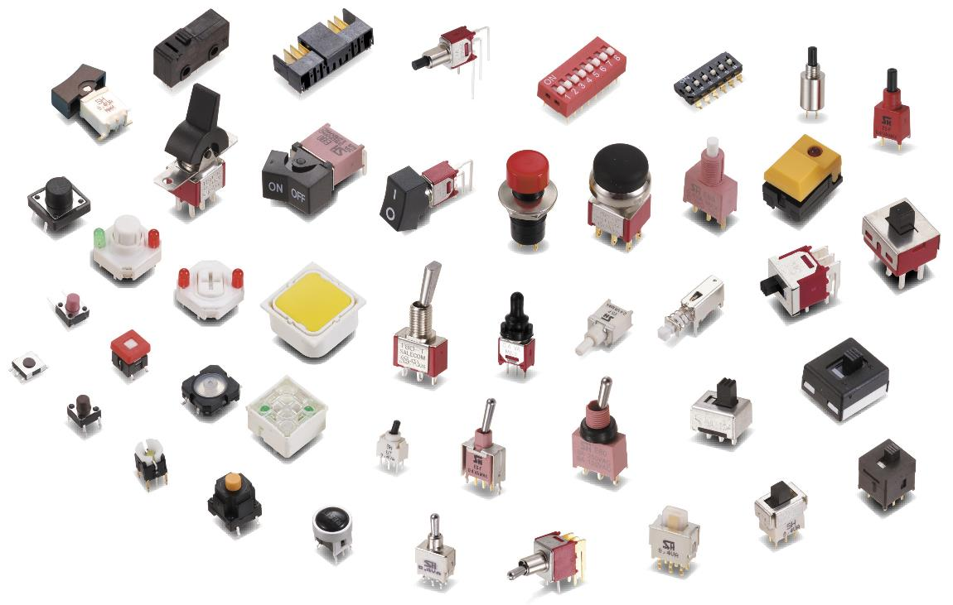
Switches

Slide 34
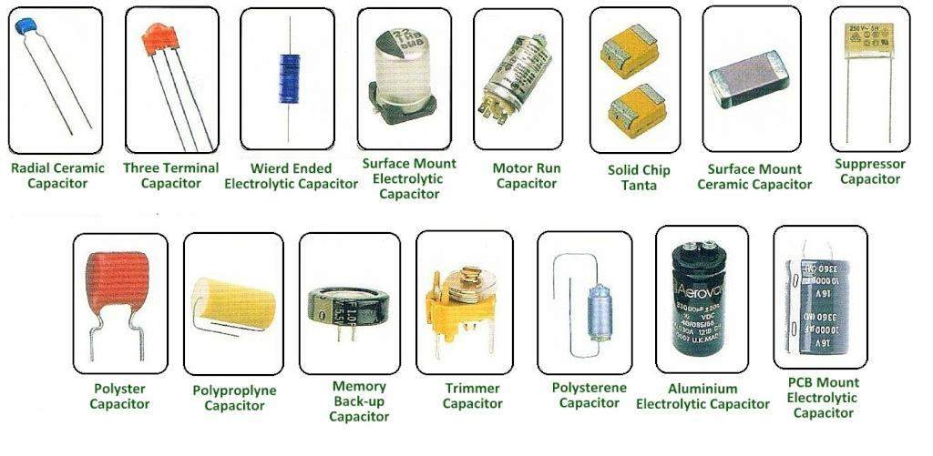
Capacitors

Slide 35
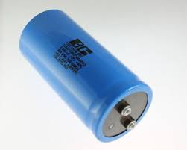
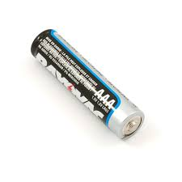
Similar to Batteries

Slide 36
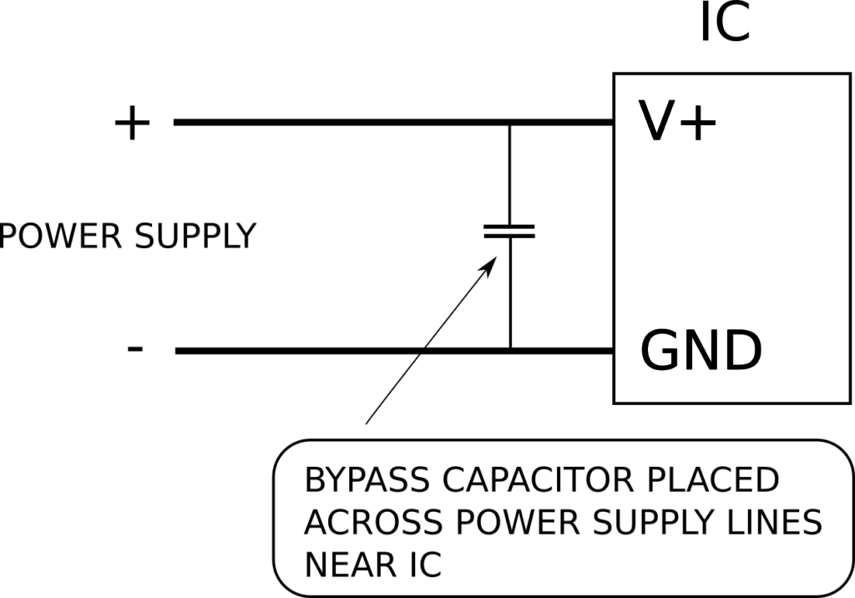
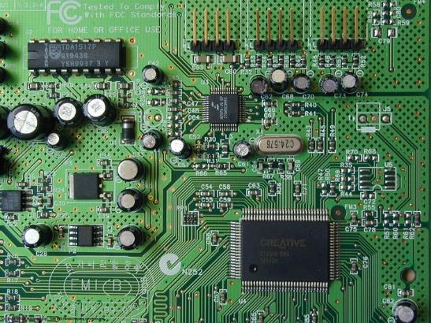
“Supply Bypass” Capacitors

Slide 37
Further Reading
Falstad Circuit Simulator – Runs in Browser
Kahn Academy – Introduction to EE
Mattermost Channel
YouTube Videos
All About Circuits
https://www.allaboutcircuits.com/education/
Sparkfun – learn.sparkfun.com

